Slide 1
EXCELLENCE in INNOVATION AWARD

Slide 2
CAMPAIGN OVERVIEW…
We created the Lovin’ Local campaign to help promote our member businesses. It was a fun and creative giveaway that allowed any type of business to participate and receive sponsorship promotion that brought awareness to their business.
All Chamber members were invited to participate.
This campaign has helped to bring attention to not only members, but the Chamber. In 2020, we successfully added 50 new members to our Chamber and had a retention rate of over 90%. We feel that this campaign has helped to increase our chamber membership by showing we are here to help support and promote local businesses.

Slide 3
HOW IT WORKED...
Campaign ran from February 1 – 14
To participate, businesses must provide a giveaway that is a minimum of $25 value. The majority went over this value and provided gift cards or items to be given away.
From all the giveaway items, we created daily packages of non-competing members.
We gave away 1 prize pack per day for 14 days.
To win, the participant had to like, share and comment on our Facebook post about the daily giveaway.
The winner was announced the next day in a Facebook post.
Participants were mentioned on our Facebook page the day their item was given away, the next day when the winner was selected, when the promotion was complete and in 2 editions of our newsletter.

Slide 4
OUTCOMES OF CAMPAIGN…
37 Chamber members participated.
Types of businesses:
Restaurants
Insurance Agencies
Medical Office
Hair Salons
Local Tourist
Attractions
Staffing Company
Accountant
Fitness Gym
Jeweler
Bank
Retail Stores
Total value of the giveaway packages each day was over $250.
Each participant was mentioned on our Facebook page, Newsletter and website.
Facebook Statistics
Total shares = 1,963
Post Likes = 1,640
Comments = 2,078
Page Likes = increased by 273
Page Follows = increased by 411
Page Views = 3,713 / up by 318%
Organic Reach = 90,087 / average of 6,006 per day from Feb. 1 – 14
Post Engagement = 31,376 / up by 233%

Slide 5
The following pages show:
The promotion our members received
Types of prizes for participants
Statistics regarding social media post

Slide 6
“The Lovin’ Local” Giveaway Information Sheet

Slide 7
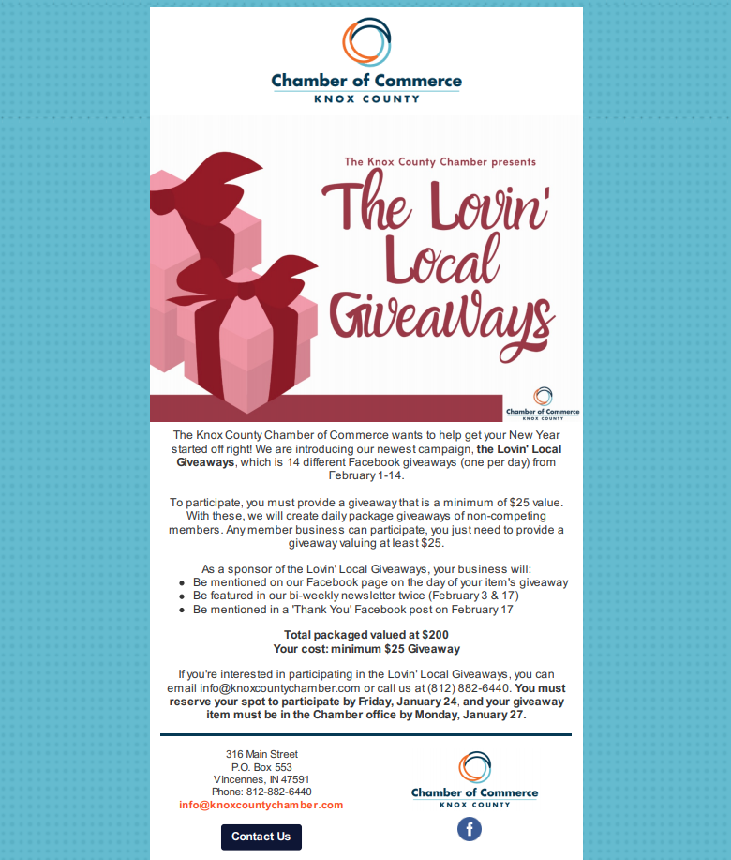
Email sent to members encouraging them to participate.

Slide 8
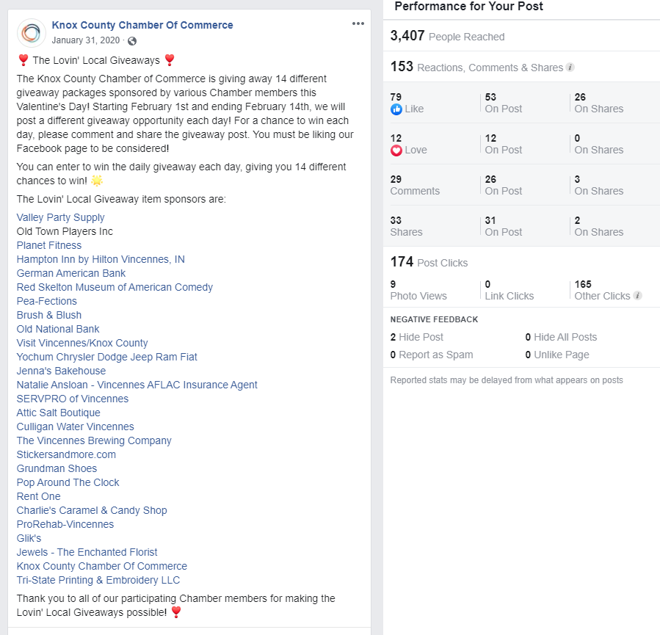
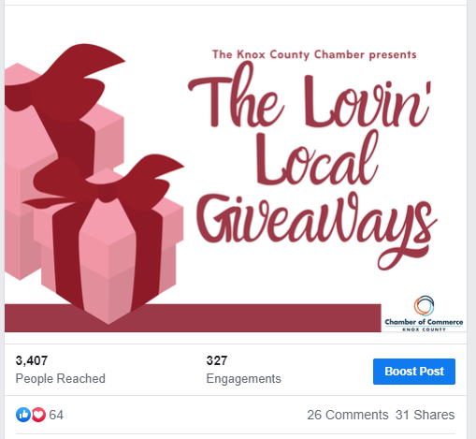
SOCIAL MEDIA EXAMPLES

Slide 9
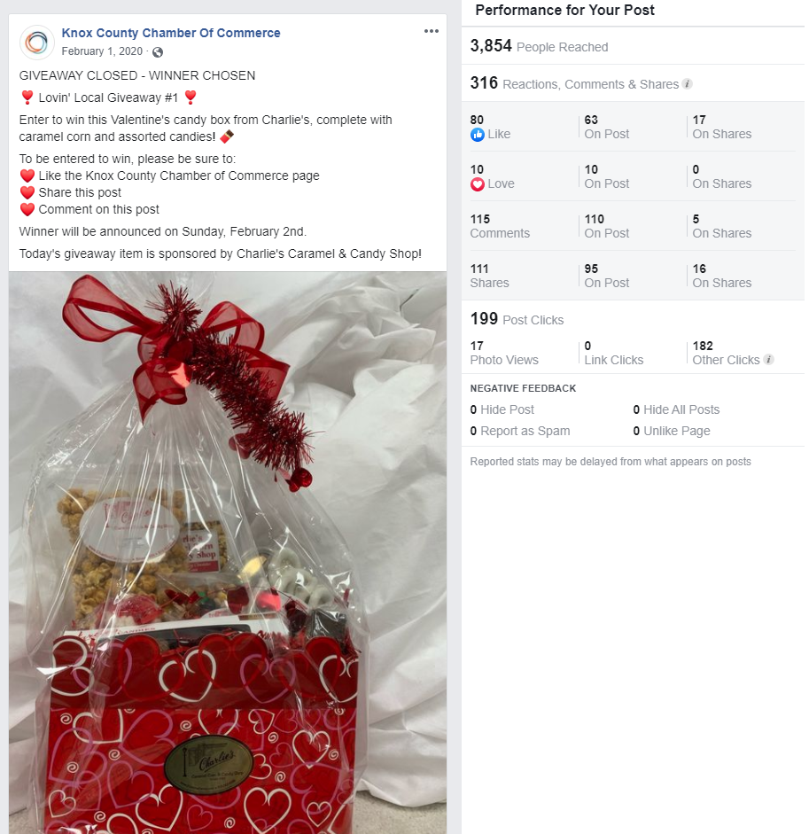
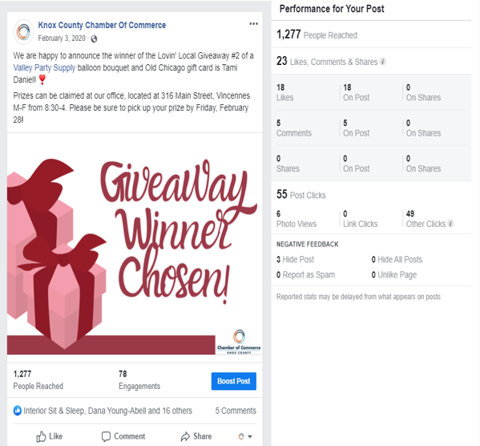

Slide 10
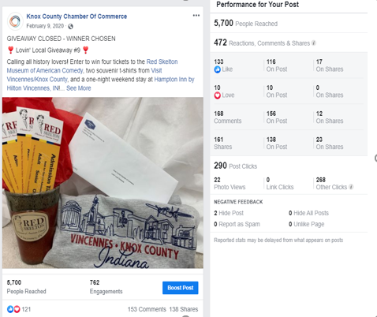
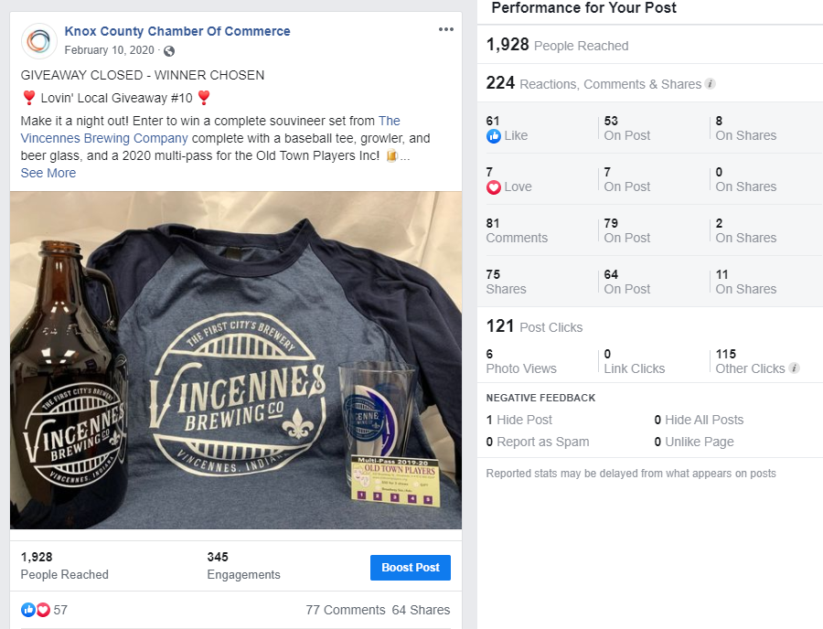

Slide 11
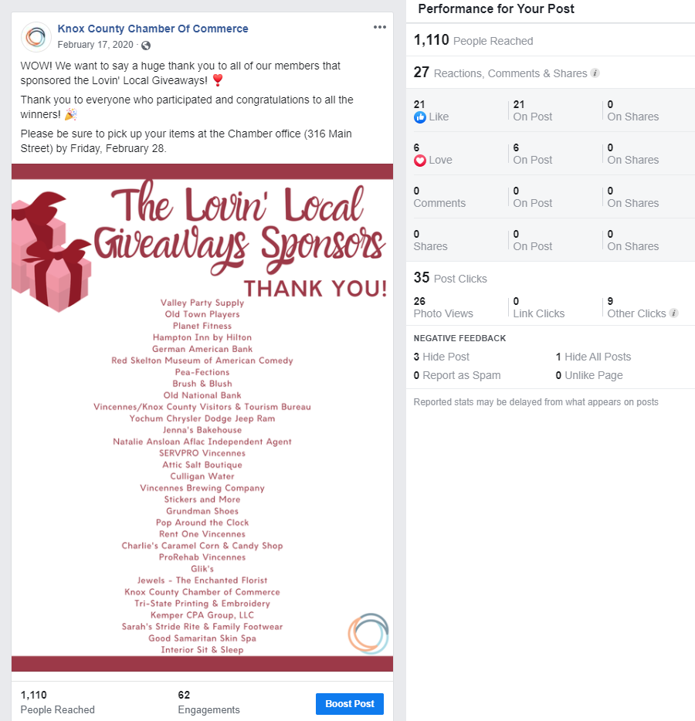
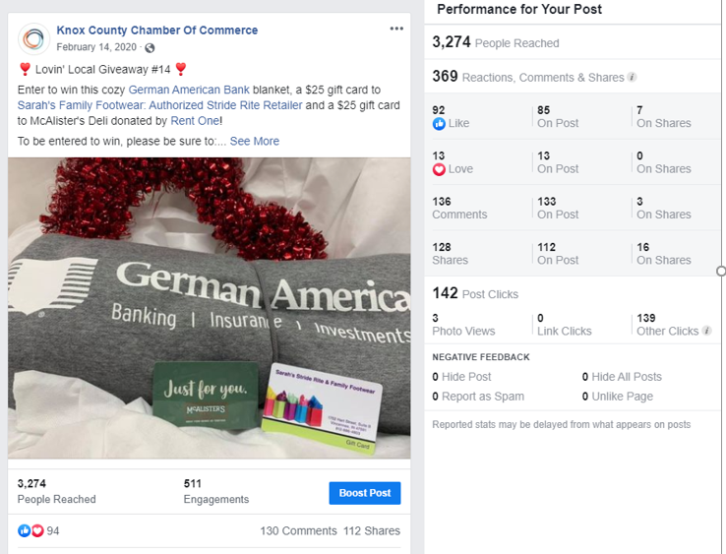

Slide 12
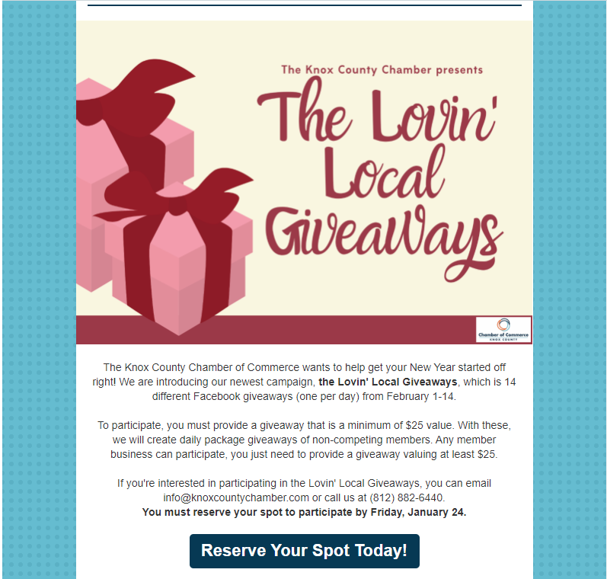
BI-MONTHLY NEWSLETTER
This is the information we put in our newsletter to solicit participants.
https://conta.cc/2R4GRia

Slide 13
Thank you for your consideration. Please contact me if you have any questions.
Jamie Neal
President
Knox County Chamber of Commerce
812-882-6440
jamie@knoxcountychamber.com

